Slide 1


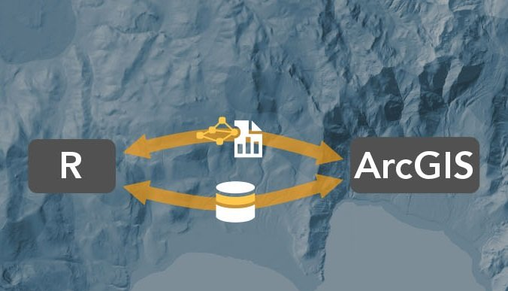
Intro to R-ArcGIS Bridge: the arcgisbinding Package
Yixuan(E Hsuan) Zhao
SUNY-Buffalo-GEO511-SDS
Course instructor : Professor. Adam M. Wilson

Slide 2



INTRODUCTION
R users can use the R-ArcGIS bridge to load ArcGIS data into their R workspaces for answering statistical questions. Accessible data is not just limited to feature class type data but also includes layers and tables.
ArcGIS developers can create tools and toolboxes to integrate ArcGIS and R capabilities. Running R scripts as tools is like running other geoprocessing tools. The tool dialog and parameter options are available for configuring the tool for execution.
ArcGIS Desktop users have access to all of the capabilities of R by simply referencing R scripts as the source file in a geoprocessing script. R also provides access to thousands of freely downloadable packages available for performing specific statistical tasks.
The R-ArcGIS bridge bridges the gap between traditional ArcGIS users and statistically based R developers. ArcGIS users can now create custom tools and toolboxes that use both the spatial and statistical capabilities found in ArcGIS and R.
As an ArcGIS user, you can now access R code through geoprocessing scripts and run the scripts in ArcGIS Desktop. R users greatly benefit in their work by having direct access to an organization's GIS data through the R-ArcGIS bridge, and they also have access to the spatial analysis tools and mapping power of ArcGIS.

Slide 3









AUTHOR
Space Analysis
Image& Remote Sensing
Visualization
Real-time GIS
3D GIS
Data collection& management
Notes:
ArcGIS是Esri公司集40余年地理信息系统（GIS）咨询和研发经验制作的一套完整的GIS平台产品，具有强大的地图制作、空间数据管理、空间分析、空间信息整合、发布与共享的能力。ArcGIS Pro 是在桌面上创建和处理空间数据的基本应用程序。它提供用于在 2D 和 3D 环境中显示、分析、编译和共享数据的工具。
arcgisbinding包旨在允许您扩展 ArcGIS 工作流程以包含 R，并扩展您的 R 分析以包含丰富的地理空间分析。通过 R-ArcGIS Bridge 的强大功能，您可以轻松地将数据从 ArcGIS 传输到 R，以访问您可能需要进一步分析的大量统计包和功能。完成后，该桥允许您将数据传输回 ArcGIS，以利用 ArcGIS 的制图、发布和共享功能。

Slide 4
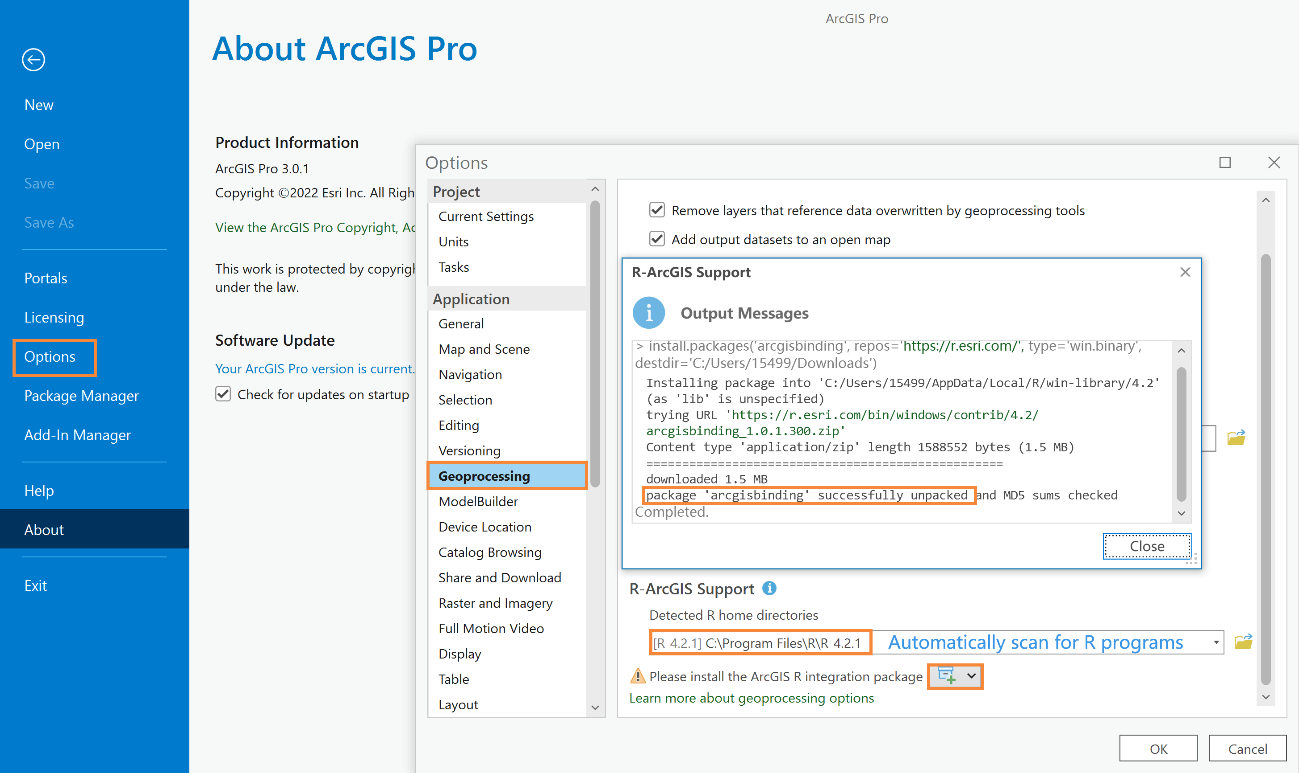

Slide 5
Functions
Use | When
arc.open(path) | Loading ArcGIS datasets, tables, and layers into an R workspace.
arc.select(object, fields, where_clause, selected, spatial_reference) | Loading a subset of the dataset into an R data frame based on specified fields and where_clause.
arc.shape(dataframe) | The shape object is required for analysis.
arc.shape2sp(dataframe) | Converting from an arc.shape_class to an sp object.
arc.sp2data(sp dataframe) | Converting from an sp data frame object to an arc.dataframe object.
arc.data2sp(dataframe) | Converting from an arc.data frame object to an sp dataframe object.
arc.shapeinfo(arc.shape(dataframe)) | Information about the geometries stored in the dataset is required. Type of geometry and spatial reference are some of the items returned.
arc.write(path, data, coords = NULL, shape_info = NULL, overwrite = FALSE) | Exporting a data frame object to an ArcGIS dataset.

Slide 6
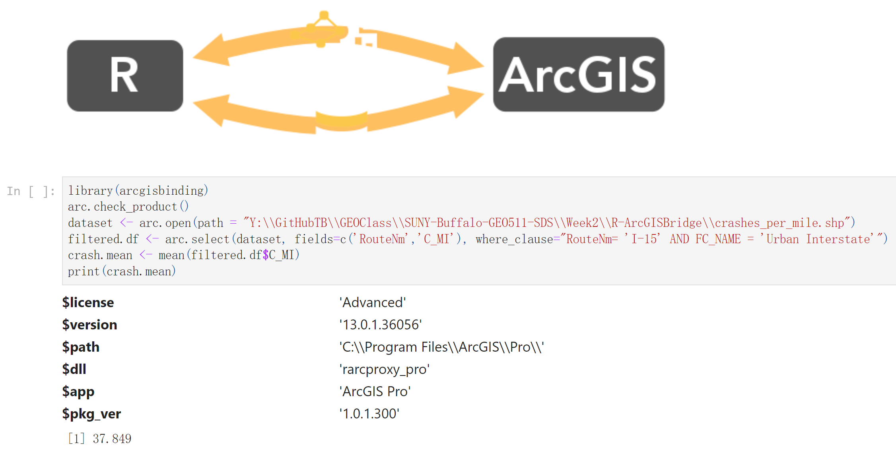
Loading a dataset into R, and finding the mean number of accidents per year per mile on I-15

